Slide 1
세상 모든 자연과 통하다
GLOBAL ECO THE SAEM
New See & Saw A.C Control

Slide 2
Profile of See & Saw A.C Control
See & Saw A.C Control
BEFORE
AFTER
Product | Price | Volume
Cleansing Foam | 9,000 | 120ml | Renewal
Toner | 9,000 | 140ml
Emulsion | 9,000 | 140ml
Cream | 12,000 | 50ml
Treatment Serum | 11,000 | 35ml
Spot Clear Gel | 8,000 | 20ml
BB Cream | 12,000 | 50ml | Drop
Mild Sun | 12,000 | 50ml
Relaxing Mask Sheet | 2,000 | 20ml
Step | Product | Price | Volume
Step 1 | Deep Cleansing Foam | 10,000 | 120ml
Step 2 | Toner | 10,000 | 160ml
 | Emulsion | 10,000 | 160ml
 | Cream | 13,000 | 60ml
Step 3 | Dark Solution | 12,000 | 30ml
 | Red Solution | 10,000 | 5ml
Renewal
Anti-trouble, Soothing Care designed for acne-prone skin and easily-irritated skin.
Mild
Redness-soothing
Oil- Control
Troubled Spot Healing & Prevents pigmentation
Step 1
Deep Cleansing
Step 2
Acne-prone & Sensitive
Skin Care
Step 3
Concentrated Troubled Spot Care
Deep Cleansing Foam
Toner
Emulsion
Cream
Red Solution
Dark Solution

Slide 3
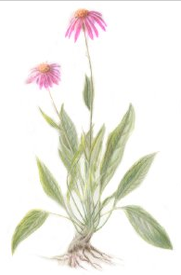
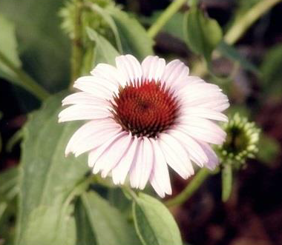
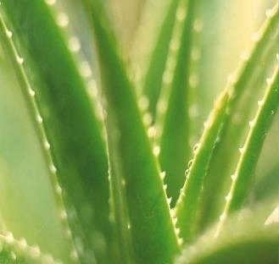
Common Ingredients for Anti-Trouble
Echinacea
Echinacea was used by the Native Americans to heal wounds after the war or hunting. They also boiled its root and drank the boiled water to stop cough.
Echinacea is century-proven herb remedy used to increase immune system and to heal the wound faster.
Benefits of Echinacea
Excellent epidermis renewal
Anti-stress
Trouble care (Anti-inflammatory, Soothing)
Green Waters (Bamboo sap, Green tea water, Aloe Vera gel)
Bamboo Sap
Bamboo is one of the fastest growing plant that can grow up to 1 meter a day.
Its sap is rich in 18 types of essential amino acids that strengthens skin’s immune system to promote healing and renewing.
Green Tea Water
Famous for its powerful antioxidant contents
Rich in Vitamin C
Contains EGCG which promotes cellular growth.
Aloe Vera
Famous for amazing soothing property.
Ultra skin-friendly: Has same pH as Human skin
96% is made of moisture
Contains many wound healing agents that soothes irritating caused by bacteria. (Great to soothe acne spots)
Helps with skin resilience.

Slide 4
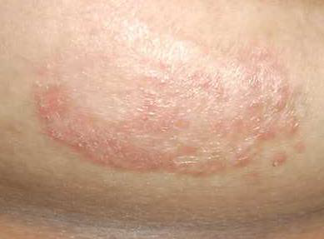
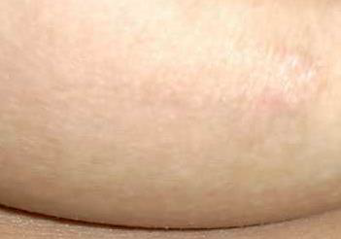
Other Ingredients
[Common] Natural Salicylic Acid to remove dead cell build-up in pores
Extracted from Wintergreen, evergreen tree that grows in Canada.
Salicylic acid is oil-soluble agent that softens dead cell and promotes its removal. Because salicylic acid is oil-soluble, it is effective working in the pore where the dead cell is mixed with sebum(lipid).
⇒ Softens dead cell build-up in pores ⇒ Promotes elimination of dead cell & sebum mixture ⇒ Prevents breakout and pore clogging.
Glycolic Acid (in Red Solution)
Glycolic Acid is the most active and beneficial of the AHA(Alpha Hydroxy Acids) that has the reputation of being one of the safest forms of AHA. It is natural substance found in sugar cane and fruit acids.
Glycolic acid softens dead skin cells, promoting the natural exfoliation of surface skin. It is especially beneficial for acne skin, because acne spots are mostly caused by clogged pores.
Madecassoside (in Dark Solution)
[BEFORE]
Highly effective wound healing ingredient extracted from Centella asiatica.
Protects the cell from inflammatory bacteria.
Promotes cell renewal
Strengthens skin’s natural protective barrier.
Calming, Soothing, Tone-brightening.
[AFTER-5WEEKS]

Slide 5
Features of Each Product
PRODUCT | Image | Main function / Selling point
Selling Points | Mild formula designed for acne-prone and easily irritated oily skin Echinacea and Green Waters takes care of redness, troubles, bacteria by soothing and excellent anti-inflammatory qualities. Natural Salicylic acid and tea tree controls excess sebum and prevents pore clogging. Treats already processed breakouts by killing bacteria and enhancing natural healing process
A.C Control Deep Cleansing Foam
A.C Control Toner
A.C Control Emulsion
A.C Control Cream
STEP 1
Trouble-preventing, deep cleansing foam with salicylic acid and sebum capturing agent.
Gentle-formula
Not overly drying like many cleansing foams designed for troubled skin.
Builds Natural Water Hold Film to increase moisture-retaining ability of the skin.
Makes abundant foam that makes the deep cleaning more effective by adsorbing impurities hiding in the pores.
STEP 2
Non-irritating, refreshing toner to remove excess sebum and soothe skin troubles.
Natural salicylic acid and tea tree controls excess sebum production
Refines skin texture
Soothes and calms.
STEP 2
Moisture Soothing emulsion soothes skin troubles and offers ultra quick absorbing moisture.
Light weight
Balances moisture and lipid
Great absorption quality
STEP 2
Oil-free moisturizing cream to supply non-sticky, moist-full moisture supply to acne-prone/ easily-irritated skin.
Fresh gel texture
Oil-free
Moist-full moisture supply makes troubled skin to optimum skin condition so that the sebaceous glands wouldn’t need to produce excess sebum.

Slide 6
Features of Each Product
PRODUCT | Image | Main function / Selling point
Selling Points | Mild formula designed for acne-prone and easily irritated oily skin Echinacea and Green Waters takes care of redness, troubles, bacteria by soothing and excellent anti-inflammatory qualities. Natural Salicylic acid and tea tree controls excess sebum and prevents pore clogging. Treats already processed breakouts by killing bacteria and enhancing natural healing process
A.C Control Red Solution
A.C Control Dark Solution
STEP 3
Intense Spot Care to soothe and prevents breakout from getting more red and inflamed by bacteria invasion. [Angry Breakout Soother]
No need to use finger.
Easy-to-carry size
Powerful soothing effect
Excellent anti-bacterial property.
Glycolic Acid helps with natural exfoliation of debris accumulated in the pore, which causes breakout.
STEP 3
Intense Spot Care prevent post-breakout pigmentation and promotes skin renewing process. [Perfect After-care Product]
Moist gel type that spreads so easily.
Builds skin renewal promoting coat that works like hydrocolloid Band-Aid.
Contains Madecassoside, the highly effective wound healing ingredient extracted from Centella asiatica. It not only soothes troubles but also prevent potential pigmentation.
Using Steps
Red Solution
[When there is new breakout, inflamed breakout]
Dark Solution
[When the breakout is calmed but you are worried about the post-mark]
Deep Cleansing
Toner
Emulsion
Oil-free Cream

